Slide 1




ApexPlanet Data Analytics Internship — Final Project
Presented by Srinivas
Computer Science & Engineering, Sreenidhi Institute of Science and Technology
APEXPLANET SOFTWARE PVT. LTD.
Notes:
1

Slide 2
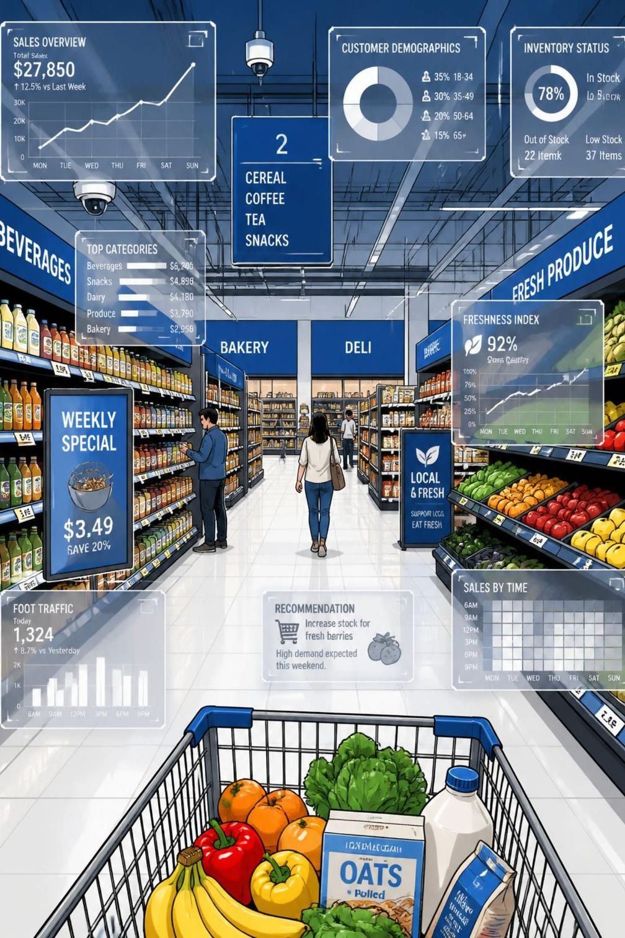
End-to-End Data Analytics on Supermarket Sales
Transform raw transactions into actionable business insights
Scope
Data cleaning → EDA → Modeling → Dashboarding → Reporting
Duration
Internship capstone project
Notes:
2

Slide 3










Problem Statement & Objectives
Data cleaning
Exploratory analysis
Extract insights using SQL
Build interactive dashboards
Statistical analysis
Forecast sales
Segment customers
Predictive models
Executive reports
Notes:
3

Slide 4
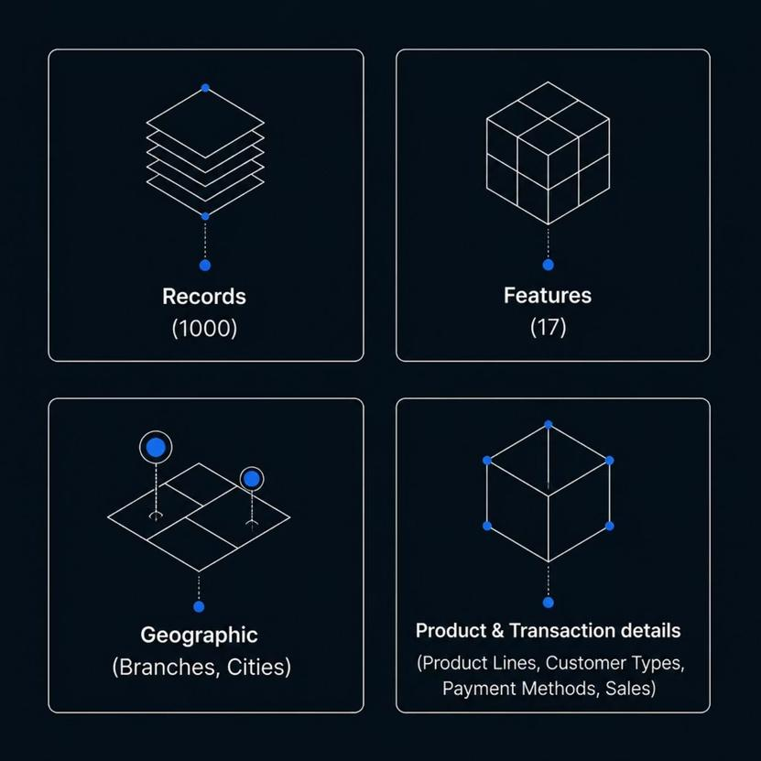




Dataset Overview
1000 Records
17 Features
Sufficient for prototyping & insights
Demographics, transaction & product fields
Branches & Cities
Product Lines & Payment
Multi-branch analysis
7 product lines, multiple payment types
Notes:
4

Slide 5

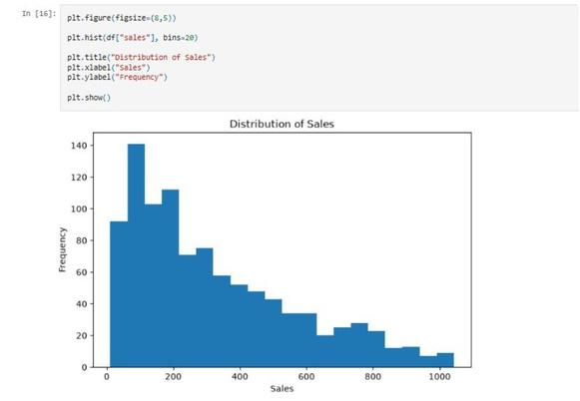
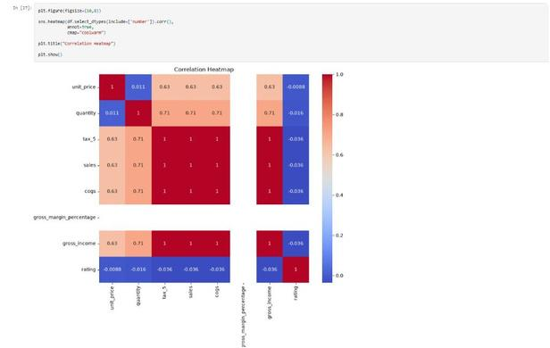
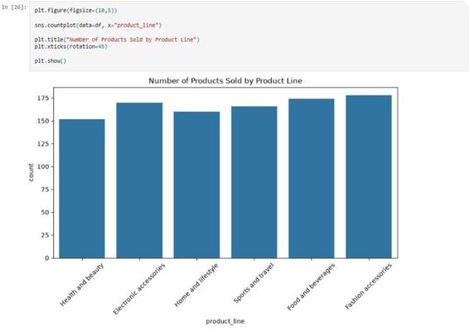
Data Cleaning & Exploratory Analysis
Before
After
Analysis
Missing values • Duplicates • Type mismatches
Cleaned rows • Consistent types • Summary stats
Correlation, product-line trends, sales distribution
Sales Distribution
Correlation Heatmap
Product Line Analysis
Notes:
5

Slide 6
Dashboard Component: KPI Cards
Dashboard components
Notes:
6

Slide 7
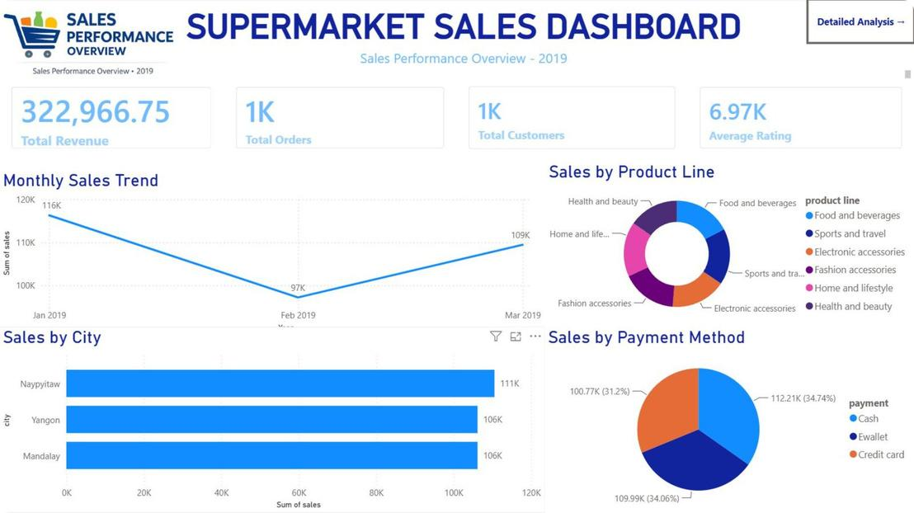
Dashboard Component: Product Line Analysis
A bar chart showing sales performance across different product lines with color-coded segments and trend indicators.
This chart clearly visualizes the sales performance of each product line, allowing for quick identification of top performers and areas needing attention within the supermarket.
Notes:
7

Slide 8
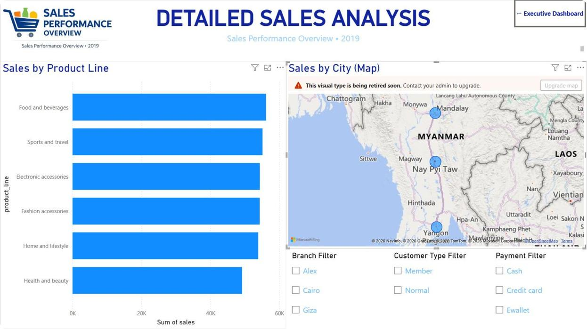
Dashboard Component: Sales by Branch
Geographic analysis showing sales distribution across different branches with interactive map filters and regional performance metrics.
Notes:
8

Slide 9
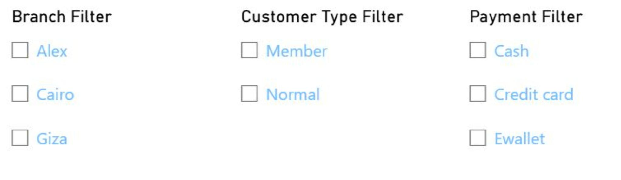
Filters & Slicers
Interactive filter controls for date ranges, product categories, branches, and customer segments to enable dynamic dashboard exploration.
Notes:
9

Slide 10

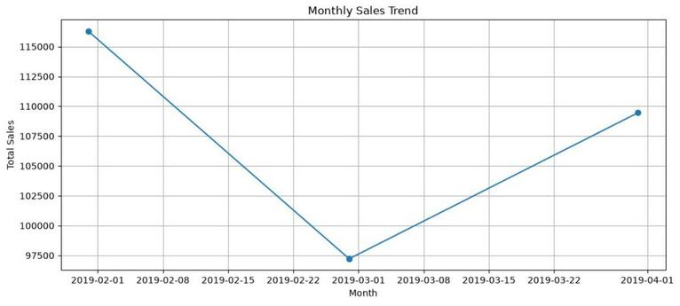
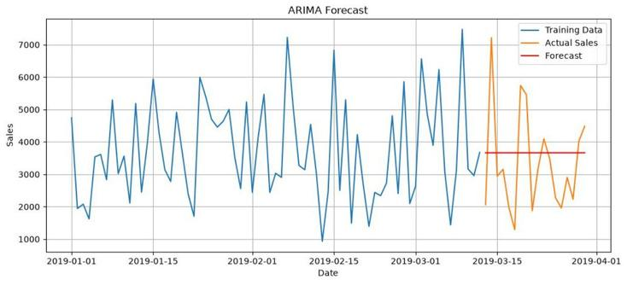
Advanced Analytics & Machine Learning
Statistical Analysis
Time Series Forecasting
Customer Segmentation
Model Training
Monthly Sales Trend & Arima Forecast
Notes:
10

Slide 11
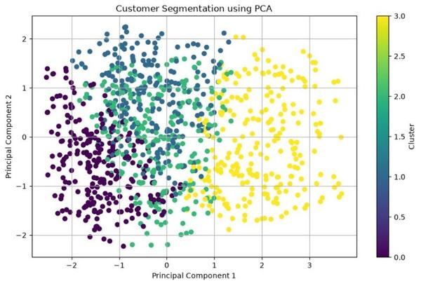
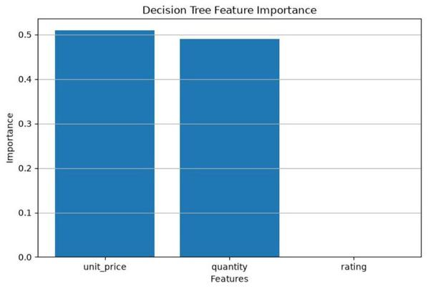
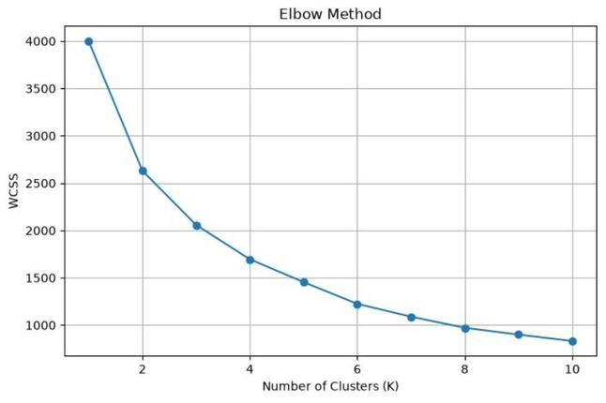
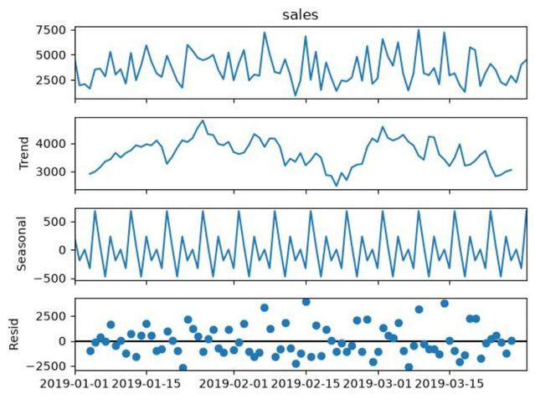
Customer Segmentation & Decision Tree Feature Importance
Elbow Method & Sal
Notes:
11

Slide 12






Business Recommendations
Improve inventory planning
Focus on high-performing product lines
Enhance customer engagement
Optimize branch performance
Use predictive analytics for planning
Automate reporting workflows
Notes:
12

Slide 13
Challenges & Learnings
Challenges
Learnings
Data preprocessing complexity
SQL integration with analytics pipeline
Dashboard usability & layout
Model evaluation & validation
Comprehensive documentation
Python (pandas, scikit-learn)
SQL (joins, window functions)
Power BI dashboarding
Statistics & Time-series methods
Machine Learning & BI automation
Version control with GitHub
Notes:
13

Slide 14
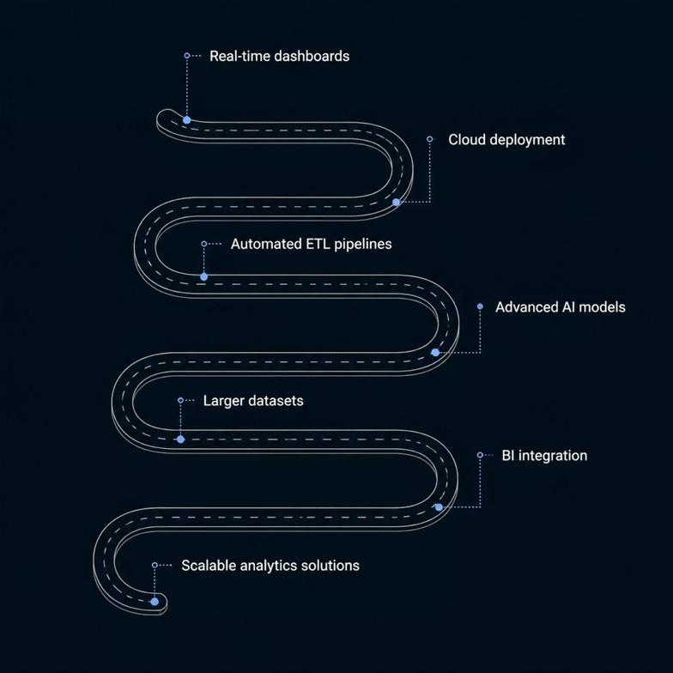


Future Scope & Roadmap
Short-term
1
Automated ETL • Real-time KPIs
2
Mid-term
Cloud deployment • Scalable storage
Long-term
3
Advanced AI models • Enterprise BI integration
Roadmap supports scale-up and productionization
Thank you — Questions?
Notes:
14

